Slide 1
Summary of Nigerian Fintech Product Trends, User Demand, and Market Positioning
By
Akwesi Duodu, Edemeka Usoroh, Orooghene Igbide and Awotide Samuel Kolade

Slide 2
Summary of Nigerian Fintech Product Trends, User Demand, and Market Positioning
Overview of Fintech Trends in Nigeria
The Nigerian fintech landscape is rapidly evolving, driven by increasing mobile penetration, internet access, and demand for digital financial services. Some key trends shaping the industry include:
Artificial Intelligence (AI) Integration: Enhancing fraud detection, personalized financial services.
Contactless Payment Solutions: Growth in biometric authentication and digital wallets.
Digital Currencies & CBDCs: The introduction of eNaira and regulatory developments.
Fintech Expansion: Increasing collaborations between banks and fintech firms.
Cybersecurity Concerns: Rising digital currency scams and AI-driven cyberattacks.

Slide 3
Fintech Product Demand Across User Segments
User Level | Popular Fintech Products
Novice | Digital Payment Solutions, Mobile Banking Apps
Intermediate | Micro-Lending Platforms, Digital Wallets
Expert | Blockchain Services, Robo-Advisory Services

Slide 4
Market Pricing Analysis of Leading Fintech Companies
Fintech Company | Key Services | Pricing Strategy
Moniepoint | Payments, Banking, Business Management | Loan structures not publicly disclosed
OPay | Mobile Payments, Food Delivery, Ride-hailing | New transaction fees introduced, specifics undisclosed
PalmPay | Digital Wallet, Money Transfers, Bill Payments | Recent fee implementations, no detailed structure available
MoMo PSB | Mobile Money, Bill Payments, Remittances | Converts foreign currency via CBN-authorized channels, pricing unclear
Paystack | Online Payments, Invoicing, Subscription Billing | 1.5% + ₦100 (Local), 3.9% + ₦100 (International)
Flutterwave | Payment Processing, Virtual Cards | 1.4% (Local), 3.8% (International)

Slide 5
Competitive Pricing Gaps & Opportunities
Transparent Fee Structures: Lack of clear pricing among most FinTechs.
Custom Pricing for SMEs: Tiered transaction fees could attract businesses.
Bundled Service Discounts: Combining payment processing with other tools.
Loyalty Incentives: Discounts for high-volume transactions.

Slide 6
Customer Segmentation & Market Positioning
Segment | Demographics | Financial Literacy | Service Preferences
Young Urban Professionals | 22-35 years, salaried employees in major cities | High | Mobile banking, digital wallets, investment platforms
Small Business Owners (Rural) | 30-50 years, entrepreneurs in retail & agriculture | Moderate | Agent banking, USSD transactions, micro-loans
Low-Income Earners | 18-45 years, informal sector workers | Limited | Cash transactions, mobile money, micro-loans
High-Net-Worth Individuals (HNWIs) | 35-60 years, executives & investors | Very High | Wealth management, premium banking apps, digital assets

Slide 7
Key Takeaways & Recommendations
Tailored Fintech Solutions: Develop products based on user literacy and needs.
Digital Payments & Banking: Target urban professionals and SMEs.
Micro-lending & Agent Banking: Focus on rural entrepreneurs and low-income users.
Wealth Management & Crypto Investments: Cater to high-net-worth individuals.
Projected Market Growth: Nigeria’s fintech sector is expected to generate $230 billion by 2025.
User Adoption: Increasing smartphone penetration (140 million users projected by 2025) will drive fintech adoption.
By implementing strategic pricing models, expanding market outreach, and enhancing cybersecurity, Nigerian fintech firms can improve user retention and competitive positioning in the financial ecosystem.

Slide 8
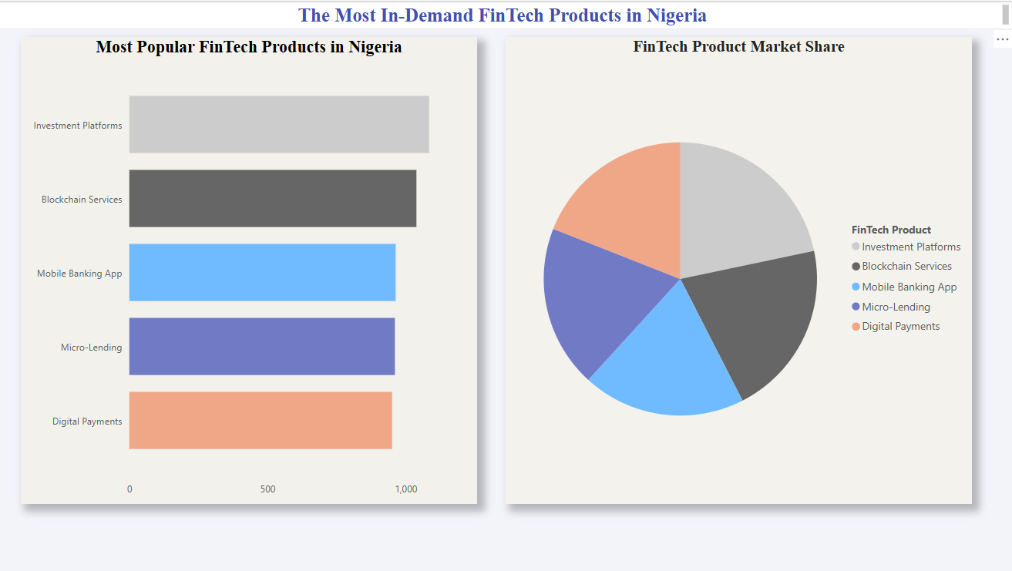
Key Findings for Research Goals

Slide 9
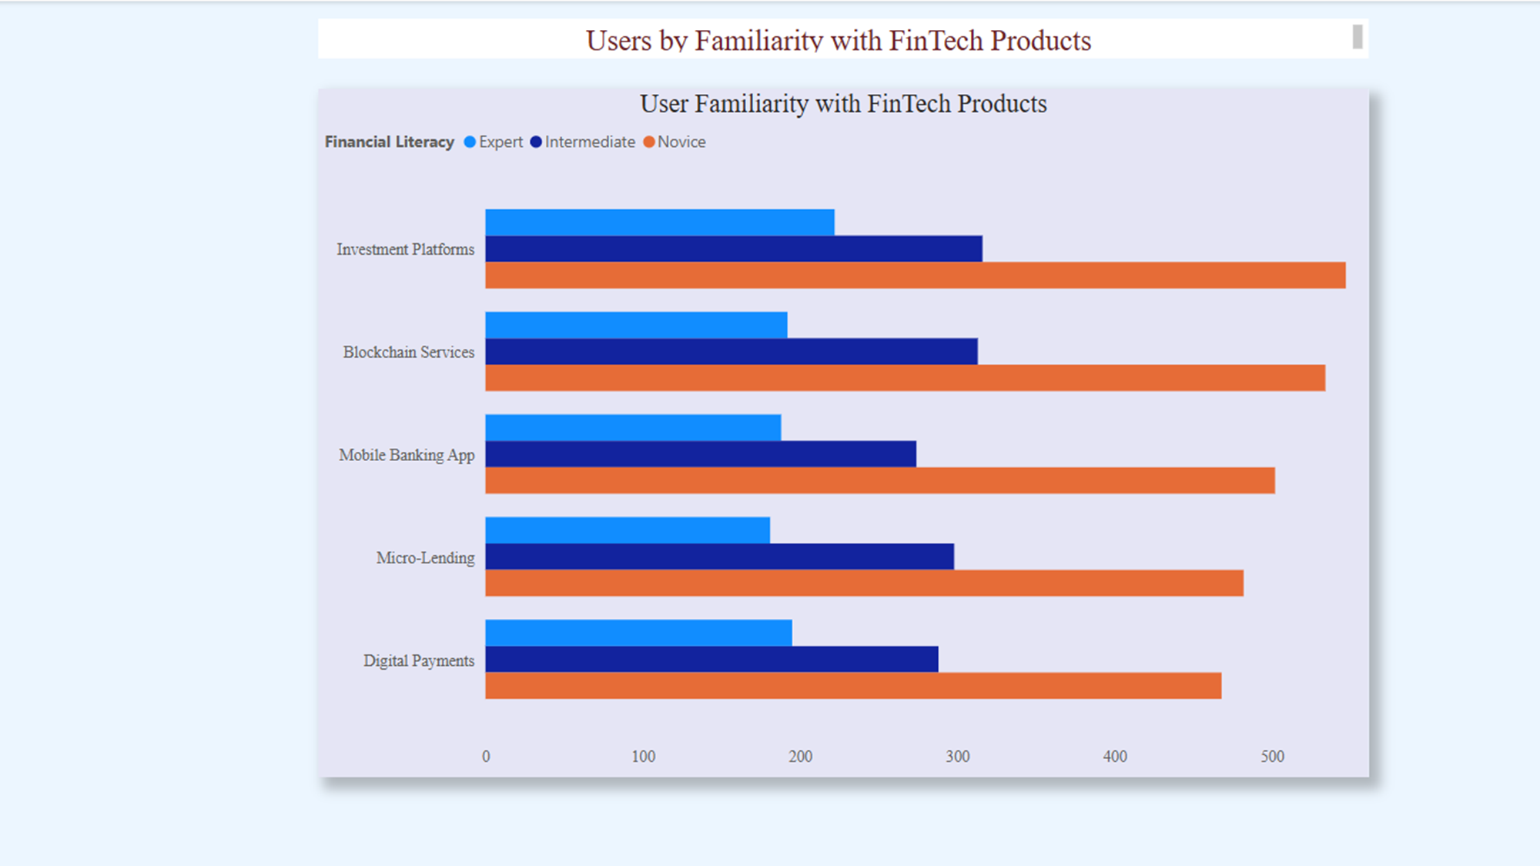
Key Findings for Research Goals

Slide 10
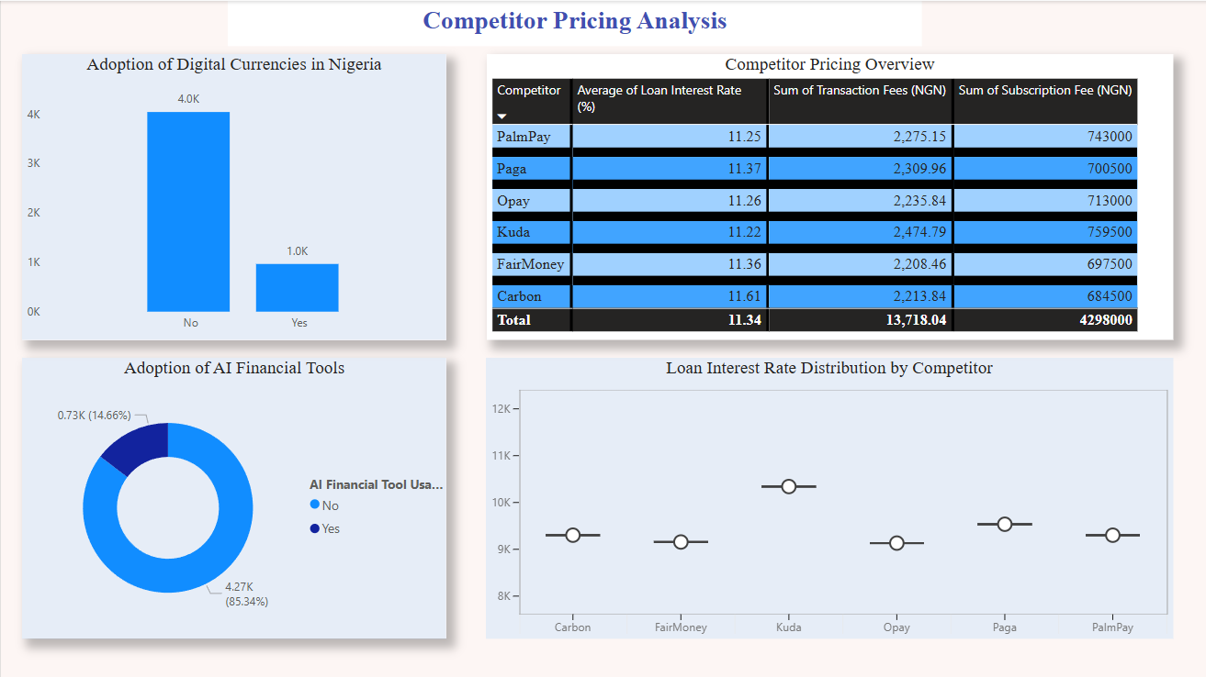
Key Findings for Research Goals

Slide 11
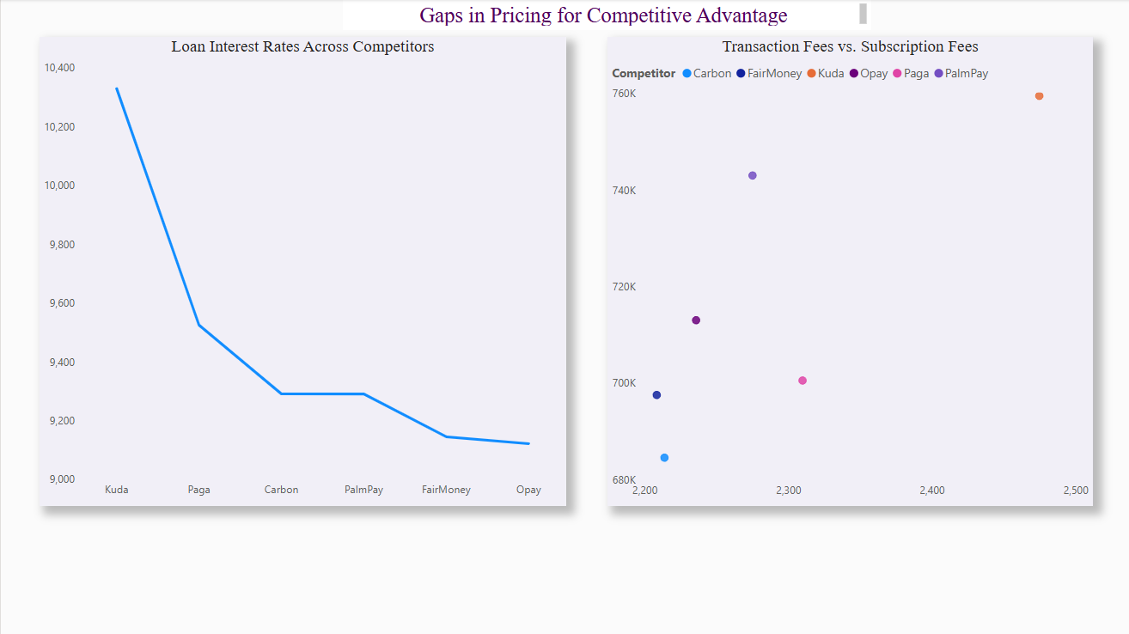
Key Findings for Research Goals

